Slide 1

Rocket Phonics

Slide 2

What is Rocket Phonics?
A fully resourced, systematic synthetic phonics programme that provides you with everything you need to teach children to read and write.
Validated by the DfE in 2021- all phonics schemes need to go through this process.

Slide 3
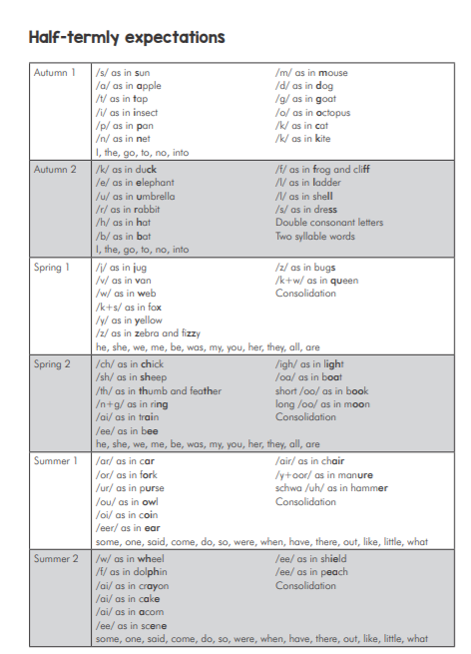
The structure of teaching…
We have launched the scheme in Autumn term 2 so we would expect our children in EYFS to be confident with sounds up to “K” and Year 1 children up to “ss/two syllable words” at Christmas.

Slide 4

How do we teach Phonics in school?

Slide 5
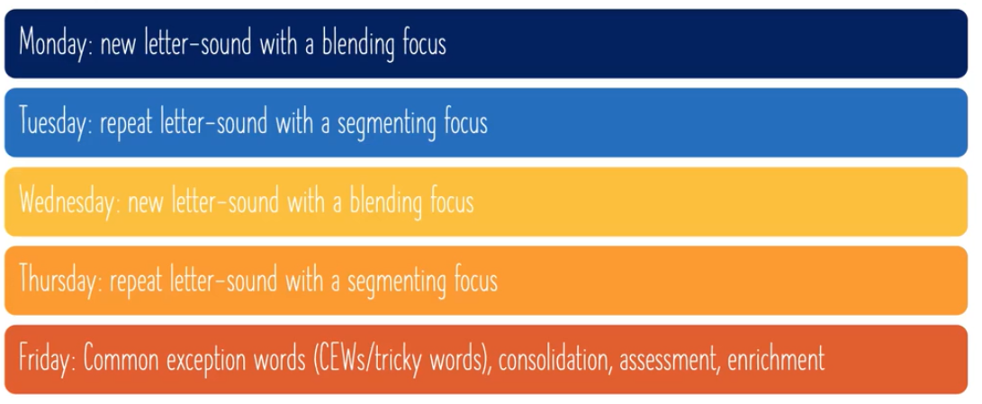
How do we teach Phonics in school?

Slide 6
What is included?
A combination of digital and printed resources (flashcards, pupil books) and a fully matched series of decodable reading books.
The scheme delivers: steady pace (2 letter sounds a week), mapped out structure (daily, weekly, yearly overviews), straightforward clarity and engaging aesthetics.
Reception learn 60 letter-sounds
Year 1 learn 70 letter-sounds

Slide 7
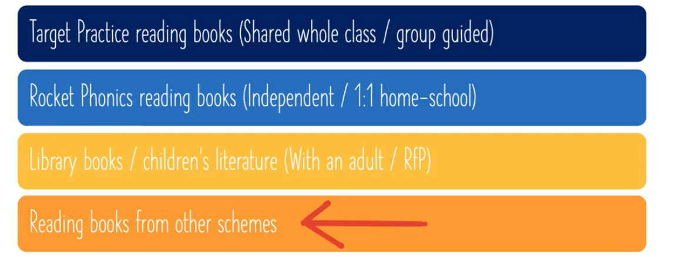
Reading books

Slide 8
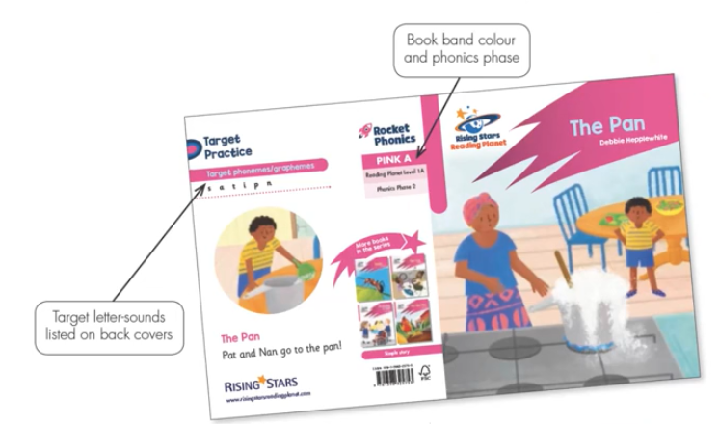
Target practice reading books
These books are used in school.
They provide focused practice of small groups or target letter-sounds. The books are fully decodable and can be used for whole-class, group-guided, 1:1 and independent reading.
They suggest 1 between 2, teacher models on the whiteboard (digital books include audio) and whole class, shared reading. This is followed by a range of activities that can be adapted and altered depending on the class and year group.

Slide 9
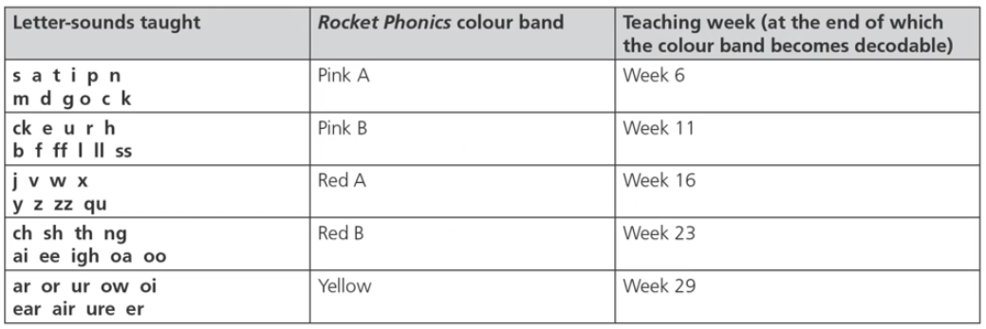
Rocket Phonics Reading books
These are ideal as they are completely decodable and match to the letter-sounds taught (there is a slight lag to ensure children can decode!) that will be shared at home. Children should be encouraged to choose the book they want from the colour band,
Comprehension sheets match to the books which may be sent as homework.
(Note, pink A books can only be sent after 6 weeks of phonics starting FS)
These can be allocated online!

Slide 10
How can you support at home?
Reading regularly: it is important that children have the opportunity to apply their phonics and reading skills at home.
Use the questions and prompts at the back of the book to support with comprehension skills.
Different activities: spot the sound, oral blending, segmenting words from the book.
Make a recording so staff can monitor when books need changing.
Good communication with school: let the teacher know how your child is getting- how are they getting on with the book?
Ensure that book bags (with diaries and books!) are brought to school everyday.

Slide 11
What books will they take home?
Your child will be sent home with 2/3 books everyday.
A levelled rocket phonics book: This will correlate with the whole-class level and match the sounds we have already explored in class so that it is fully decodable.
A ‘library book’- this is a book that the children can choose off the shelf that they may/may not be able to decode themselves. This is best shared with a family member so that they are being exposed to high level vocabulary and hear a range of texts. (Starting in Jan)
An enrichment book: to ensure children are challenged where needed.

Slide 12
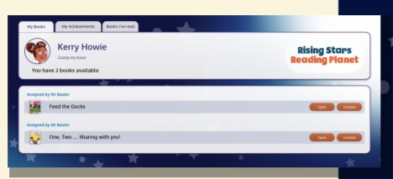
Is there any access to the online resources?
Rocket Phonics Online can be accessed from any computer, tablet or mobile phone connected to the internet.
You can log in via: https://my.risingstars-uk.com
You will be given your child’s login details and School ID, provided by the school in due course. These login details will be provided over the next term to all children in EYFS/Year 1. If you have any problems with the login process, please contact your child’s teacher.
Once the eBooks have been assigned to your child, they will appear in the pupil dashboard (in the ‘My Books’ section) when you log into Rocket Phonics Online. Click on the ‘Open’ button to launch the book on your screen.

Slide 13
Any questions?

