Slide 1
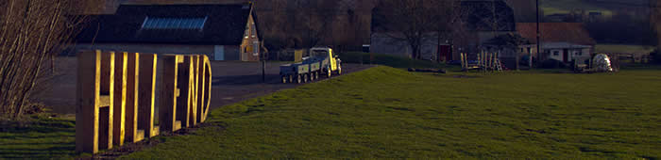
Year 4 Hill End

Slide 2
Staff
The members of staff that will be going with your children are:
Miss Paterson
Miss Warrington
Mr Williams (first aid trained)
Mrs Edwards
Miss Thompson (first aid trained)
Mrs Kirby (first aid trained)
Mr Hunter
Mrs Rhodes

Slide 3
Dropping off
Drop off at Hill End on Wednesday 8th October between 8.45am and 9.15am.
Collect at Hill End on Thursday 9th October between 2.00pm and 2.30pm.
Any trouble with dropping off or collecting, please come and see us.
Please let us know if your child will be going home with a different adult.

Slide 4
Itinerary
Wednesday | Thursday
Day 1 – Anglo Saxon workshop all day led by an expert - Time in our dorms - Games and stories | Day 2 - Team building activities - Orienteering

Slide 5
What is included
A cooked evening meal
Evening snack and hot chocolate
Breakfast (Thursday only)
Lunch (Thursday only)
Snacks and drinks throughout the day on Thursday.
Please provide your child with a packed lunch and a fruit snack for Wednesday.
Please ensure they have a named re-fillable water bottle with them.

Slide 6
Sleeping arrangements:
2 dorms – Split into girls’ and boys’ rooms.
Children will need a sleeping bag and a pillowcase
We will work with the children to decide who they are going to share a room with.
Kit List

Slide 7
Medical Needs and Allergies
If your child takes daily medication, or will require medication whilst at Hill End, please complete the medical form to enable school to administer the medication to your child.
Please contact the school office with any updated allergies that we need to be aware of asap.
Please provide up to date emergency contact numbers.

Slide 8
Questions…

